Slide 1
Tracking anything in high quality
PROJECT REVIEW
E. Gabriel Jomar
Krishi Thiruppathi

Slide 2
About the project
HQTrack mainly consists of a video multi-object segmenter (VMOS) and a mask refiner (MR)
HQTrack first segments the target objects for each frame via VMOS.
To improve the segmentation performance, especially perceiving tiny objects, we cascade a GPM with 8× scale and expand the propagation process to multiple scales.
In VMOS, Intern-T is employed as our encoder to enhance object discrimination capabilities
SAM scales up segmentation models by training with a high-quality annotated dataset. HQ-SAM introduces a few additional parameters to the pre-trained SAM model.
We take the prediction mask from VMOS as the input of MR.
Finally, the output mask of HQTrack is selected from the mask results from VMOS and HQ-SAM.
Specifically, we find that for the same target object, the mask refined by HQ-SAM is sometimes completely different from the predicted mask of VMOS (very low IoU score) which instead harms the segmentation performance.
So we set an IoU threshold τ (between masks from VMOS and HQ-SAM) to determine which mask will be used as the final output. Here, the IoU score is higher than τ , we choose the refined mask.

Slide 3
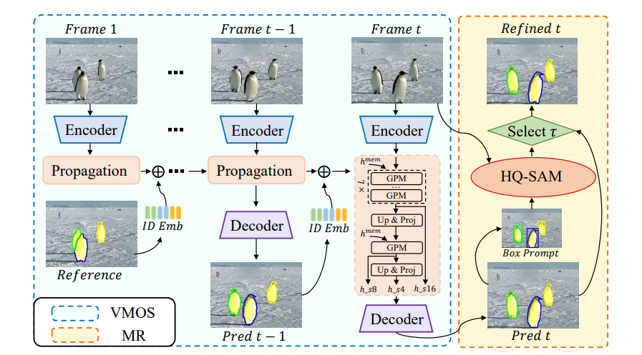
Base model architecture

Slide 4
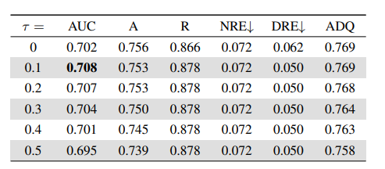
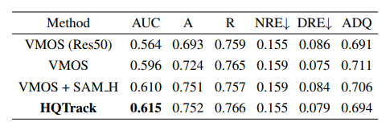
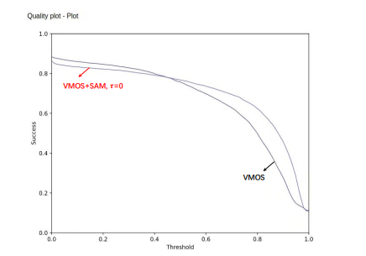
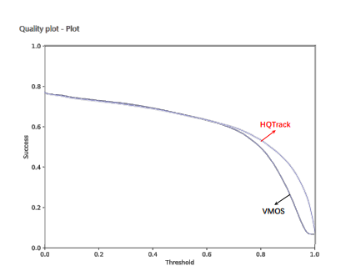
Base model results
Tracking performance with different threshold τ on VOTS2023 validation set. Mask refiner (MR) is a SAM H model.
Performance on VOTS2023 test set.
VMOS v.s. VMOS + SAM on VOST2023 validation set. SAM is employed to refine all the masks from VMOS.
VMOS v.s. HQTrack on VOST2023 test set

Slide 5
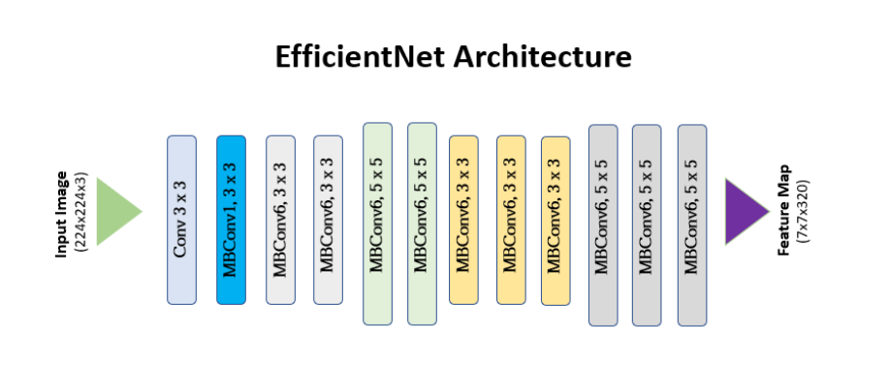
AREas of growth
Here the threshold value set to select mask results from VMOS and SAM (calculating IoU score between the masks from VMOS and SAM) is 0.1 - yields the most promising results. Setting τ in the range of 0-0.1 might increase AUC value.
Instead of employing Intern-T as encoder, other CNN feature extraction models such as Deformable Convolutional Networks (DCNs) or EfficientNets can be utilized
There is a possibility that Batch tracking method can outperform Joint tracking where all target objects get joint tracked with a single tracker. Batch tracking also will have a better understanding of the relationship between the target objects which makes the tracker obtain better robustness to distractor interference and is also gives a better AUC value than single tracking.
A more robust long-term memory mechanism could be developed to improve the tracking accuracy in challenging scenarios.

Slide 6
Related works
1. FairMOT: On the Fairness of Detection and Re-identification in Multiple Object Tracking (Zhang et al., 2020)
FairMOT is a multiple object tracking (MOT) method that addresses the fairness issue between detection and re-identification tasks equally. In previous MOT methods, the detection task is typically treated as the primary task, and the re-identification task is treated as a secondary task. This can lead to unfairness, as the detection task can be biased towards objects that are easier to detect.
2. CenterTrack: Single-Object Tracking with Center Point Representation (Zhou et al., 2021)
CenterTrack is a single-object tracking method that represents objects as center points . This representation is simple and efficient, and it allows CenterTrack to track objects in a variety of challenging scenarios, such as occlusions, fast motion, and cluttered scenes.

Slide 7
THANK YOU

